Slide 1
PROJECT INITIATION DOCUMENT
Distance Based on Location Project

Slide 2
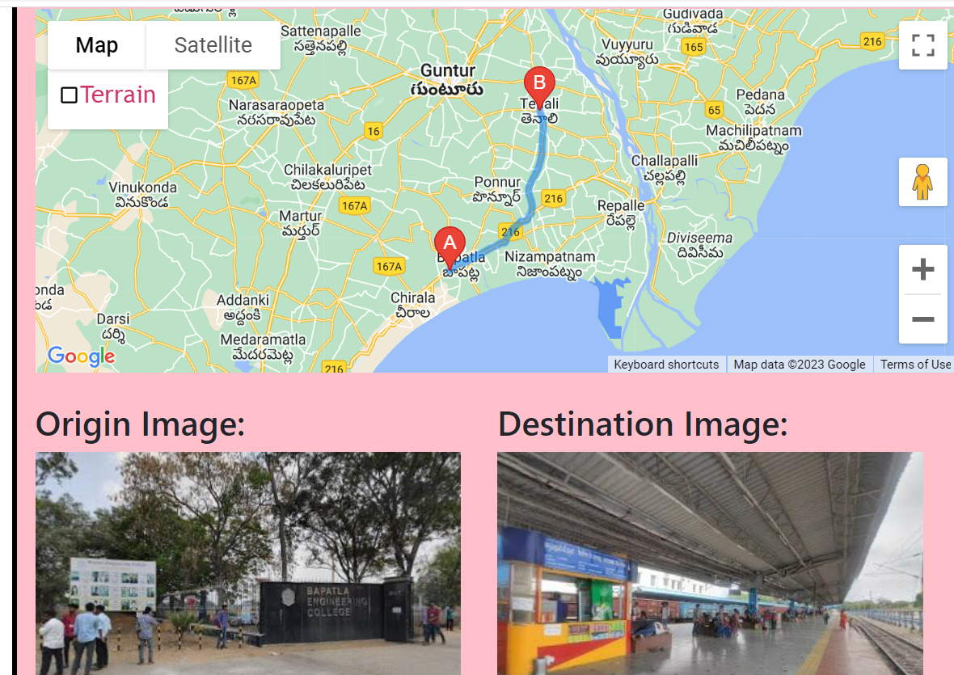
INTRODUCTION
Project Scope
Project Objective
Project Exclusion
Project Deliverables
Project Success Factors
Communication Plan:
project resourcing strategy
Project Key Stakeholders:
Project Risk

Slide 3
Project Definition
The project involves the development of a web-based distance calculator application. The application allows users to calculate the distance between two locations, display the route on a map, and provide street view images of the origin and destination locations.
The application is built using HTML, CSS, JavaScript, and integrates with the Google Maps API and Google Places Autocomplete API.

Slide 4
Project Scope:
The scope of the project includes the development of the distance calculator application with the mentioned features.
It covers the implementation of the user interface, distance calculation functionality using the Google Maps API, map display with directions, retrieval and display of street view images, and error handling.
The project does not include additional advanced features like multiple waypoints, alternative routes, or real-time traffic information.

Slide 5
Project Objective:
The objective of the project is to create a user-friendly and intuitive distance calculator application that enables users to easily calculate the distance between two locations, view the route on a map, and obtain visual representations of the origin and destination locations.
The application aims to provide accurate and reliable distance information to assist users in their travel planning and decision-making..

Slide 6
Project Exclusion:
The project excludes the development of advanced features such as multiple waypoints, alternative routes, or real-time traffic information.
It also does not include integration with external services or databases for additional functionalities like weather information or point-of-interest recommendations.

Slide 7
Project Deliverables:
Fully functional distance calculator web application.
User interface design and implementation.
Integration with the Google Maps API for distance calculation, map display, and route directions.
Integration with the Google Places Autocomplete API for address auto-completion.
Retrieval and display of street view images for the origin and destination locations.
Error handling and validation of user inputs.
Documentation and user guide for the application.

Slide 8
Project Success Factors:
Accurate and reliable distance calculation between two locations.
User-friendly interface that is intuitive and easy to use.
Proper integration with the Google Maps API and Google Places Autocomplete API.
Responsive and visually appealing design.
Efficient retrieval and display of street view images.
Effective error handling and validation.
Positive user feedback and satisfaction.

Slide 9
Communication Plan:
The project team will communicate through regular meetings and updates.
The team will use a combination of in-person meetings, video conferences, and email communication.
Progress updates, milestones, and any issues or changes will be communicated to all relevant stakeholders promptly.

Slide 10
Project resourcing strategy
The project will be executed by a team consisting of web developers, designers, and quality assurance professionals.
The team members will have expertise in HTML, CSS, JavaScript, and APIs.
The project manager will oversee the team and allocate resources accordingly to ensure timely completion of tasks.

Slide 11
Project Key Stakeholders:
Project Manager: Oversees the entire project and ensures its successful completion.
Developers: Responsible for implementing the application's functionality and integrating with the necessary APIs.
Designers: Create a visually appealing and user-friendly interface.
Quality Assurance Team: Ensures the application functions correctly and meets the required standards.
End Users: Utilize the application to calculate distances between locations.

Slide 12
Project Risk:
API Limitations: The project is dependent on the Google Maps API and Google Places Autocomplete API. Any limitations, changes, or issues with these APIs could impact the application's functionality.
Technical Challenges: There may be technical challenges related to integrating the APIs, retrieving street view images, or handling user inputs accurately.
User Acceptance: The application may not meet all user expectations or may have usability issues that need to be addressed to ensure user satisfaction.
Time Constraints: The project may face time constraints that could impact the development process and delivery timelines.
Data Accuracy: The accuracy of distance calculations and the availability of street view images rely on the data provided by the Google Maps API, which may not always be 100% accurate or up to date.

Slide 13


